Slide 1
Week 1
Module Code:LAW604
Module Title: Civil Litigation and Advocacy
Learning outcomes:
Enable students to identify and critically explain the principles of legal professional ethics as they apply to Civil Litigation matters, and the duties of the adviser and advocate.

Slide 2
Assessment Details
2 Assignments worth 50% each.
Assignment 1 (AS1): Will take the form of a 15-minute advocacy presentation. The presentation will take place in the week commencing 29 July 2024 and the submission deadline is 2 August 2024 at 3pm.
Assignment 2 (AS2): Will take the form of a 2,500 word project. The deadline for this assessment is Tuesday 27 August 2024 at 3pm.

Slide 3
Assessment Opportunities
Importance of submitting
First submission: Submitted before deadline marked as a percentage. 40% to pass. If you are late submitting (up to 7 days) capped at 40%. Must submit to be entitled to a rework the original submission.
Resubmission: If submit and receive under 40% entitled to resubmit the same assignment reworked. Will be capped at 40%.
If do not submit the first submission you will be provided with a new assignment brief. Will be capped at 40%.

Slide 4
Assessment Opportunities
Importance of submitting
Number of Submission Attempts: You only have one resit opportunity.
If you do not pass within the two opportunities available to you: Then you will only be permitted a third opportunity at the discretion of the assessment board. The board will have your full academic profile available to them when they exercise their discretion.
If you are permitted a third attempt: This may impact your progression and may be asked to to repeat the module with attendance, this may result in you incurring more fees and delaying you completing your studies.

Slide 5
How You Will Be Assessed
Assessment Briefs
Learning Outcomes: The assessments are designed to assess knowledge underpinning module learning outcomes. You can find details of these on the assessment briefs and on the module descriptors on the syllabus area of canvas.
The assessment briefs : Will contain the question and task. They will also contain a list of requirements that should be followed. These should all be available at the end of the first week of teaching on the syllabus page of Canvas.
Plans: During class time we will discuss plans as to how you can approach answering the questions but these are only a suggestion designed to help you meet the requirements and you must consider the marking rubrics or criteria when completing your assessments.

Slide 6

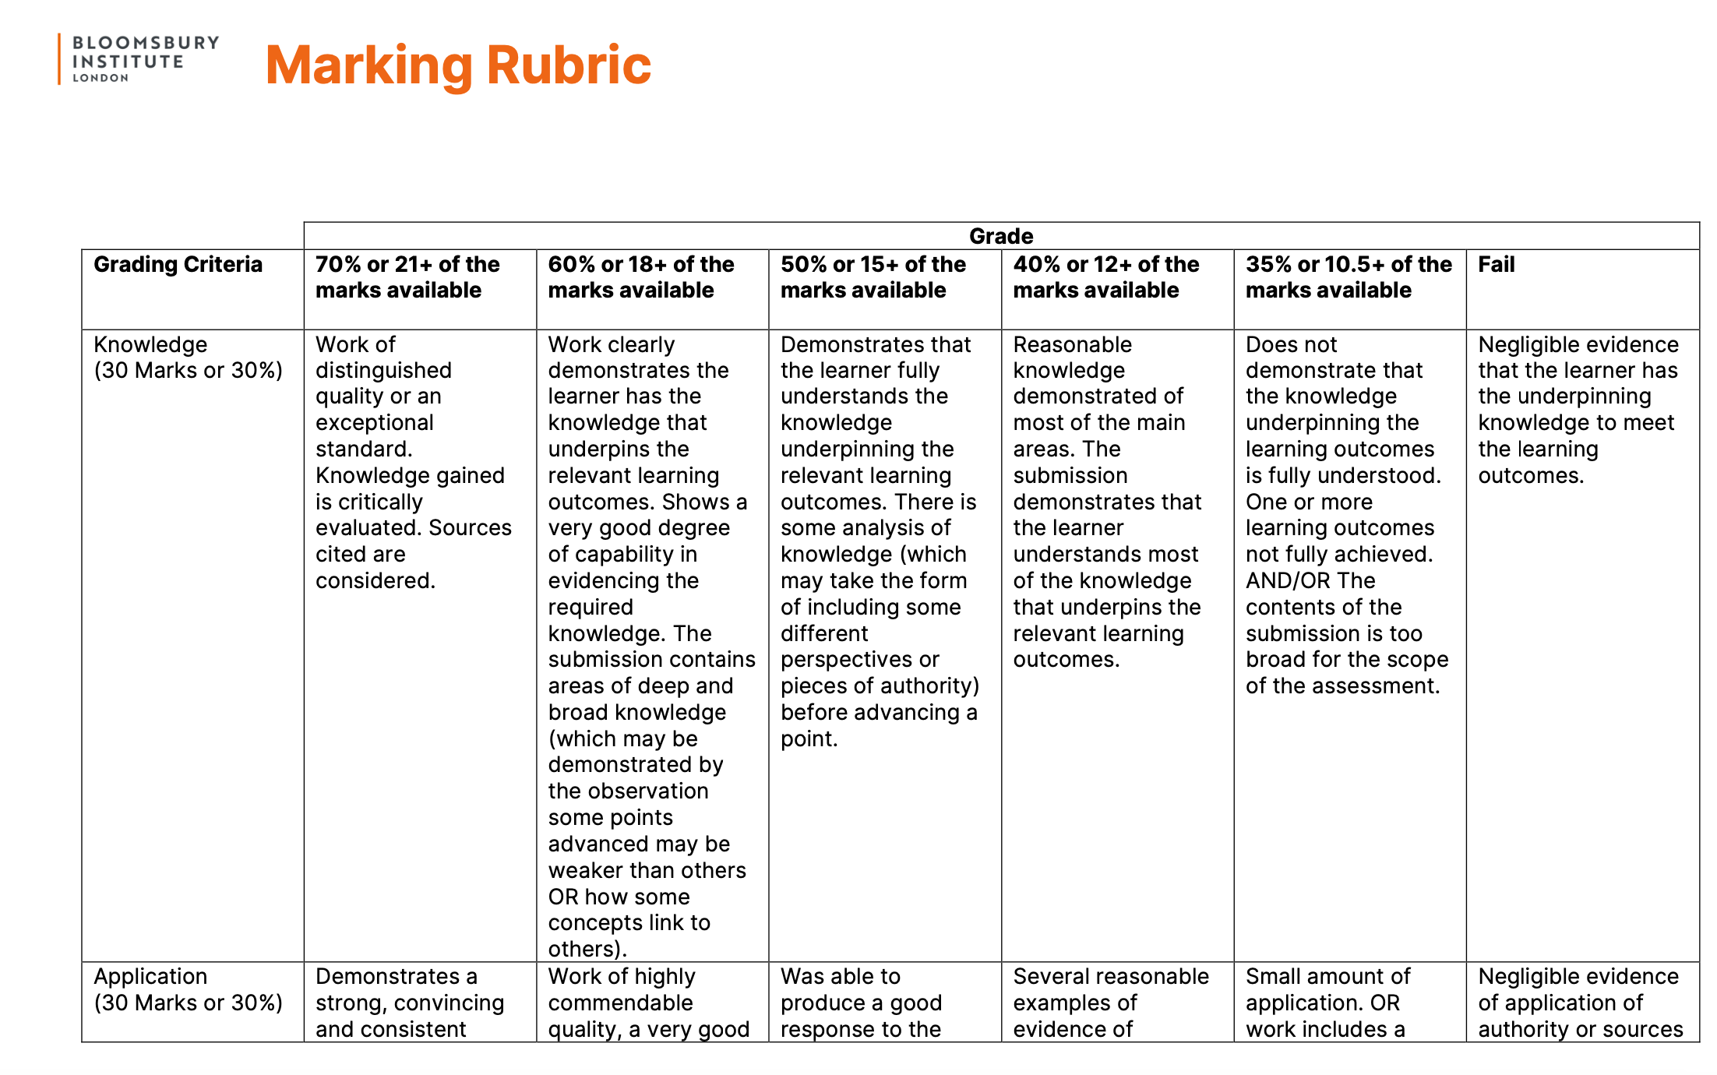
How You Will Be Assessed
Marking Criteria
Thinking Skills
Marking Rubric: You will be marked with the assistance of a marking rubric. Please ensure you refer to the rubric when working on your assignment. The rubric can be found on the syllabus area of the module canvas page.
Lower Order:
Knowledge
Higher Order:
Analysis
Creativity

Slide 7

Creativity
You could recommend areas that need reform AND/OR suggest innovation or innovative approaches
Analysis
Here you are required to comment on things like certainty, fairness AND/OR comment on the sources themselves
Application
Once you identify the law and where it is found you then say why it is relevant and how it operates
Knowledge
At it’s simplest this is stating what the law is and where the law can be found

Slide 8
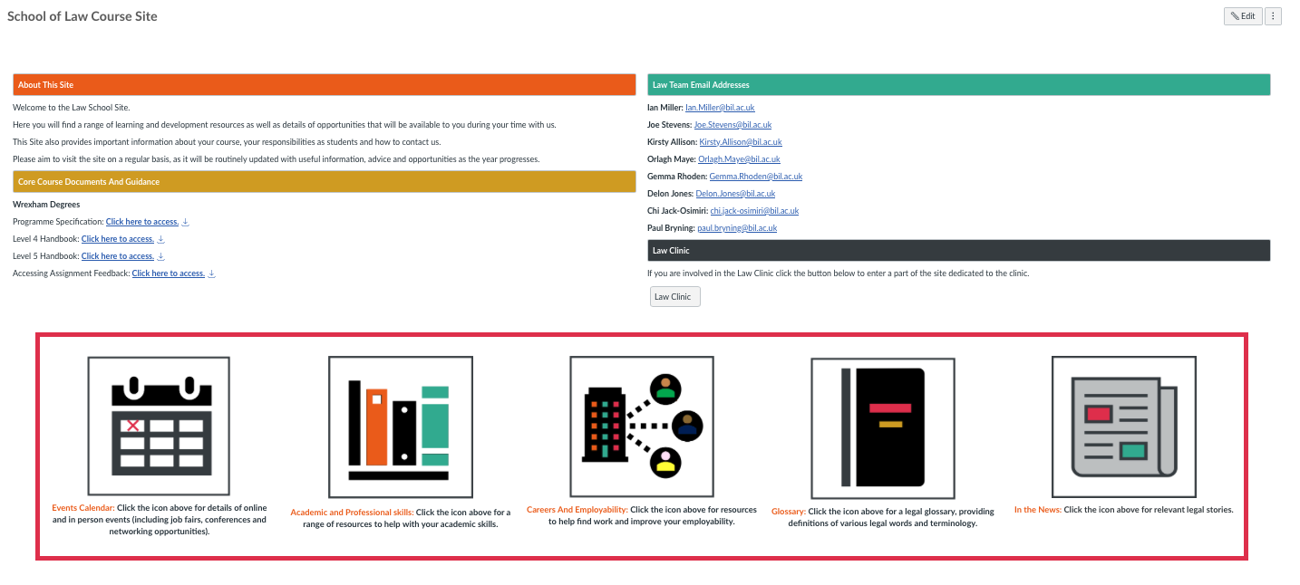

Resources
Tutors and the
Law School Canvas Page
Drafts: Tutors will accept drafts, those should be sent to us at least a week ahead of the deadline in order to give us time to come back to you.
Academic Resources: On the Law School Canvas page there are resources for you to use including those on the academic and professional skills page.

Slide 9
Seminar Objectives
Discuss the way civil procedure is governed with reference to 1 set of rules and the 1 overarching objective
Explain the requirement for parties and the courts to further the overriding objective with reference to 2 pieces of the CPR
Explain the importance of maintaining trust and acting fairly when instructed in a civil litigation claim with reference to 3 paragraphs of the SRA Code of Conduct for Solicitors, RELs and RFLs
Describe the lawyer’s duty to the court with reference to 3 paragraphs of the SRA Code of Conduct for Solicitors, RELs and RFLs
Explain the requirements on conflicts, confidentiality and disclosure with reference to 3 paragraphs of the SRA Code of Conduct for Solicitors, RELs and RFLs

Slide 10

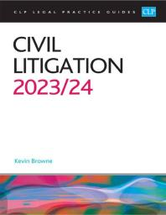
For the following activities you should read: Browne, and Catlow. Civil Litigation 2023/2024 : Legal Practice Course Guides (LPC), College of Law Publishing, 2023. ProQuest Ebook: Chapter 1: Introduction to Civil Litigation
www.bil.ac.uk

Slide 11
Seminar Objective
1. Discuss the way civil procedure is governed with reference to 1 set of rules and the 1 overarching objective

Slide 12
The Woolf Reforms
Civil litigation in England and Wales changed fundamentally on 26 April 1999, when the Civil Procedure Rules 1998 (CPR 1998) (SI 1998/3132) came into force.
The Rules were the courts’ attempt to implement the ‘Woolf Reforms’ which were set out in Lord Woolf’s report, Access to Justice, which was published in 1996.
Lord Woolf hoped that his proposed reforms, now enshrined in the CPR 1998, would lead to a civil justice system that was:
just in the results it delivered;
fair in the way it treated litigants;
AND
easily understood by users of that legal system.
www.bil.ac.uk

Slide 13
It was hoped that the new system would also provide:
appropriate procedures,
at a reasonable cost
which could be completed within a reasonable time-scale.
Lord Woolf thought it necessary to: transfer the control of litigation from the parties to the court.
The court would then determine how each case should progress by:
making appropriate directions
e.g. setting strict timetables and ensuring that the parties complied with them
To ensure compliance this meant there must also be a system of sanctions which the court could impose itself without the need for an application by any party.
www.bil.ac.uk

Slide 14
The Rules
The CPR 1998 apply to virtually all types of civil litigation proceedings in England and Wales.
The Practice Directions
In order to understand and interpret the Rules correctly, it is necessary also to look at the Practice Directions which supplement the Rules.
The Practice Direction (PD) for a particular Rule is often more expansive than the Rule itself. In a sense, the Practice Direction puts flesh on the bare bones of the Rule.
www.bil.ac.uk

Slide 15
The Overriding Objective
The overriding objective of the reforms is set out in CPR 1.1
CPR 1.1(1): The CPR are a procedural code with the overriding objective of enabling the court to deal with cases justly and at proportionate cost.
In Maltez v Lewis (1999) The Times, 4 May: The claimant’s application was for a court order that the defendants should be prevented from instructing leading or senior counsel in a case as the claimant had only been in a position to instruct a junior counsel of seven years’ experience. The court did not have a power to require a party to change their lawyers, but the court was able to ensure compliance with the overriding objective.
For example: If one party had instructed a big firm of expensive solicitors and the other party could only afford to instruct a small firm then the court could and should ensure that a level playing field was achieved.
www.bil.ac.uk

Slide 16
The Prevalence of the Overriding Objective
The overriding objective must be borne in mind at all times when conducting civil litigation, both by the court, because CPR 1.2 states:
The court must seek to give effect to the overriding objective when it:
exercises any power given to it by the Rules
OR
interprets any rule subject to rules 76.2, 79.2 and 80.2, 82.2 and 88.2.
and by the parties and their legal advisers, because CPR 1.3 states:
The parties are required to help the court to further the overriding objective.
www.bil.ac.uk

Slide 17

Question 1:
What examples are given in your reading about how the court may go about achieving a level playing field was achieved between the parties?
Question 2:
What do CPR 76.2, 79.2 and 80.2, 82.2 and 88.2 provide?
www.bil.ac.uk

Slide 18
Answer 1:
On disclosure by allowing the smaller firm more time.
In the preparation of trial bundles the court could direct that the larger firm prepared them.
The court has power to prevent a party being unfairly required to pay excessive costs because the other party has instructed unreasonably expensive advisers.
Where one of the parties is unable to afford a particular procedure, the court, should be entitled to make its order conditional upon the other side meeting the difference in costs of the weaker party, whatever the outcome.
www.bil.ac.uk

Slide 19
Answer 2:
CPR 76: Deals with proceedings under the Prevention of Terrorism Act 2005.
CPR 76.2: This part of the CPR modifies the overriding objective and where this Part applies, the overriding objective in Part 1, and so far as relevant any other rule, must be read and given effect in a way which is compatible with the duty set out. The court is under a duty to ensure that information is not disclosed contrary to the public interest. Subject to that duty the court must satisfy itself that the material available to it enables it properly to determine proceedings.
www.bil.ac.uk

Slide 20
CPR 79: Deals with proceedings under the Counter-Terrorism Act 2008, part 1 of the Terrorist Asset-Freezing etc. Act 2010 and part 1 of the Sanctions and Anti-Money Laundering Act 2018.
CPR 79.2: This part of the CPR modifies the overriding objective and where this Part applies, the overriding objective in Part 1, and so far as relevant any other rule, must be read and given effect in a way which is compatible with the duty set out. The court is under a duty to ensure that information is not disclosed contrary to the public interest. Subject to that duty the court must satisfy itself that the material available to it enables it properly to determine proceedings.
www.bil.ac.uk

Slide 21
CPR 80: Deals with proceedings under the Terrorism Prevention and Investigation.
CPR 80.2: This part of the CPR modifies the overriding objective and where this Part applies, the overriding objective in Part 1, and so far as relevant any other rule, must be read and given effect in a way which is compatible with the duty set out. The court is under a duty to ensure that information is not disclosed contrary to the public interest. Subject to that duty the court must satisfy itself that the material available to it enables it properly to determine proceedings.
www.bil.ac.uk

Slide 22
CPR 82: Deals with closed material procedure.
CPR 82.2: This part of the CPR modifies the overriding objective and where this Part applies, the overriding objective in Part 1, and so far as relevant any other rule, must be read and given effect in a way which is compatible with the duty set out. The court is under a duty to ensure that information is not disclosed in a way which would be damaging to the interests of national security. Subject to that duty the court must satisfy itself that the material available to it enables it properly to determine proceedings.
www.bil.ac.uk

Slide 23
CPR 88: Deals with closed proceedings under the Counter-Terrorism and Security Act 2015.
CPR 88.2: This part of the CPR modifies the overriding objective and where this Part applies, the overriding objective in Part 1, and so far as relevant any other rule, must be read and given effect in a way which is compatible with the duty set out. The court is under a duty to ensure that information is not disclosed contrary to the public interest. Subject to that duty the court must satisfy itself that the material available to it enables it properly to determine proceedings.
www.bil.ac.uk

Slide 24
Seminar Objective
2. Explain the requirement for parties and the courts to further the overriding objective with reference to 2 pieces of the CPR

Slide 25
Parties’ duty to further overriding objective
In a sense, all the other rules in the CPR 1998 are designed to try to achieve the overriding objective.
Parties’ duty to the court.
Professional conduct.
CPR 1.3
Lawyers and their clients have a positive duty to help the court to further the overriding objective.
Commercial Court Guide (para A1.10)
The Court expects a high level of co-operation and realism from the legal representatives of the parties. This applies to dealings (including correspondence) between legal representatives as well as dealings with the Court.
www.bil.ac.uk

Slide 26
Principle 7 of the SRA Standards and Regulations and Principle 5 of the CILEx Code of Conduct
Each party, whether legally represented or not, is required to help the court to further the overriding objective. But a party has no duty or obligation to their opponent.
A regulated lawyer has a duty to act in their own client’s best interests, and that more often than not will be disadvantageous to the interests of their client’s opponent.
These SRA and CILEx Principles require that solicitors and CILEx lawyers act act in the best interests of each client.
The best interests of the client require a lawyer to act in a manner which furthers the interests of each client and does not put the client's interests in conflict, or at significant risk of conflict with either the lawyer’s own interest, or those of another client.
www.bil.ac.uk

Slide 27
Principle 1 of the SRA Standards and Regulations and Principle 1 of the CILEx Code of Conduct
A lawyer owes certain duties to the court and is bound by standards of professional conduct set by their regulator. This reflects the public interest in the proper administration of justice; the public interest, also covering the litigants themselves, being expressed in the overriding objective of the court dealing with each case justly.
The first of the SRA and CILEx Principle also requires a solicitor to act in a way that upholds the proper administration of justice.
A solicitor or CILEx Lawyer must not mislead the court, must not interfere with the judicial process, and must conduct themselves in such a way that they act in the interests of justice.
www.bil.ac.uk

Slide 28
Before the introduction of the CPR 1998, the speed at which cases progressed was largely determined by the parties’ solicitors.
Under the CPR 1998, the court has a duty to manage cases and will therefore determine the pace of the litigation.
www.bil.ac.uk

Slide 29
Question 3:
Use Westlaw to find Buchanan v Stennett [2022] EWHC 3550 (Ch). Write a short summary of the case.
Question 4:
What did Deputy Master Glover say in Buchanan v Stennett [2022] EWHC 3550 (Ch) at [17] about CPR 1.3?
Question 5:
What does CPR 1.4 state?
www.bil.ac.uk

Slide 30
Answer 3:
The court considered two applications for summary judgment in a music management and publishing rights claim, in the context of limitation defences, fiduciary duties, sub-fiduciary duties and solicitors' duties to both clients and non-parties
Answer 4:
CPR 1.3 encourages parties to engage at all stages of litigation, not least to enable them to better understand one another’s cases, which then enables the parties to focus issues for the court to determine.
Answer 5:
The court must further the overriding objective by actively managing cases.
www.bil.ac.uk

Slide 31
Seminar Objective
3. Explain the importance of maintaining trust and acting fairly when instructed in a civil litigation claim with reference to 3 paragraphs of the SRA Code of Conduct for Solicitors, RELs and RFLs

Slide 32
Civil litigation is a high-pressure environment in which to practice. That pressure can emanate from a variety of different sources, and there are times when the behaviour of clients who are desperate to be successful in their claim or defence can conflict with a solicitor's professional duty to the court. This can lead to a range of potential ethical issues arising for lawyers practising in the area of dispute resolution.
It is important to understand the nature of some of these issues
www.bil.ac.uk

Slide 33
Maintaining trust and acting fairly
When dealing with civil disputes, you must maintain trust in your relationship with your client. The Codes of Conduct set out ways in which you can achieve this.
www.bil.ac.uk

Slide 34
Para 1.1 of the SRA Code of Conduct for Solicitors, RELs and RFLs
You do not unfairly discriminate
Dispute resolution can be a particularly acrimonious arena. Parties to disputes can display behaviour towards each other outside the court room which you, as a legal representative, could find distasteful or inappropriate.
They could belong to political parties or movements which do not align with your own views. It is important that you do not let any personal feelings you have towards the way in which your client may have behaved affect your professional conduct in any way. Examples can include:
not allowing any difference in political viewpoints to affect the way in which a solicitor represents a client
not allowing a client's sexual orientation to change the nature of the relationship between a solicitor and their client.
www.bil.ac.uk

Slide 35
Question 6:
Ron is a solicitor specialising in boundary disputes and is a member of a local group which campaigns for additional funding to support victims of domestic violence. He is representing Gary and Sheila, who are involved in a dispute with their neighbour about the position of the boundary fence between their respective properties. Sheila contacts Ron to tell him that Gary has just told her that he has a previous conviction for assaulting his former partner three years ago. She gives Ron written authority to receive instructions from Gary on her behalf, as the pressure of the litigation is getting to her, and she wants to concentrate on her relationship with Gary.
What should Ron do in this situation?
www.bil.ac.uk

Slide 36
Answer 6:
Ron should continue to act for Gary and Sheila and, if there is a written authority signed by Sheila authorising Ron to accept instructions from Gary on her behalf, he should do so. Whilst Gary's previous conviction clearly conflicts with Ron's personal views, this should not affect his conduct of the litigation or his professional relationship with Gary.
www.bil.ac.uk

Slide 37
Para 1.2 of the SRA Code of Conduct for Solicitors, RELs and RFLs
You do not abuse your position by taking unfair advantage of clients or others
As part of your practice in dispute resolution, you will inevitably encounter litigants in person.
When you do, you must be careful to ensure that you do not use your position as a solicitor to threaten or pressurise them into agreeing to something on the basis that they do not know any better. For example, a solicitor cannot tell an unrepresented claimant that they will make as many procedural applications as possible to frustrate the litigation, run up costs, and delay trial if the claimant does not accept an undervalued settlement proposal.
Likewise, a solicitor cannot use their position to persuade their client to accept a settlement which is substantially lower than that to which they are entitled so that, for example, the file could be closed thus reducing that solicitor's workload.
www.bil.ac.uk

Slide 38
Para 1.4 of the SRA Code of Conduct for Solicitors, RELs and RFLs
You do not mislead clients, the court or others
A solicitor should not mislead or attempt to mislead their clients, the court, or others, either by their own acts or omissions, or by allowing or being complicit in the acts or omissions of others (including their client). Whilst this may seem obvious, there are many instances of solicitors breaching this part of the Code.
It is important to bear in mind that a solicitor does not need to act intentionally to be in breach of this professional requirement; it is an objective assessment as to whether they have done so.
www.bil.ac.uk

Slide 39

Example:
let us look at a potential scenario where a solicitor is representing a claimant at trial. They did not draft the witness statements and, due to pressure of time in advance of the trial, only read them very briefly. In their summary, the judge referred to one of the claimant's witnesses as having stated something which they did not.
The solicitor, as they did not read the statement properly, fails to correct the judge. This would be an instance of a solicitor misleading the court, albeit unintentionally, and therefore breaching the Code.
www.bil.ac.uk

Slide 40
Misleading a client
Solicitors can mislead clients by, for example:
informing them that their case is progressing well when, in fact, it has failed
stating that a case is proceeding through court when it has not been issued
backdating a letter sent to a client informing them that they have done something when they have not.
www.bil.ac.uk

Slide 41
Misleading the court
Solicitors can mislead the court by, for example:
signing a claim form, or particulars of claim, on behalf of a client when they know it contains a material fact which is untrue
allowing counsel to make a misleading statement to the court when the solicitor knows that it is untrue
making a false representation to the court about an opponent's conduct in their absence at a hearing.
www.bil.ac.uk

Slide 42
Misleading another party to the proceedings
Solicitors can mislead another party to the proceedings by, for example:
having instructions from their client that they will accept an offer of settlement from their opponent, but informing their opponent that their client will only accept a higher amount
indicating that their client has instructed counsel to represent them at a mediation or hearing when this is not the case
indicating that they have sought the opinion of an expert when this is not the case.
www.bil.ac.uk

Slide 43
Seminar Objective
4. Describe the lawyer’s duty to the court with reference to 3 paragraphs of the SRA Code of Conduct for Solicitors, RELs and RFLs

Slide 44
Dispute resolution and proceedings before courts, tribunals, and inquiries
A solicitor's primary duty is to the court. Part 2 of the SRA Code of Conduct for Solicitors, RELs and RFLs deals with the way in which a solicitor must behave in order to uphold their primary duty.
www.bil.ac.uk

Slide 45
Para 2.2 of the SRA Code of Conduct for Solicitors, RELs and RFLs
You do not seek to influence the substance of evidence
A solicitor must not influence the substance of evidence, including generating false evidence or persuading witnesses to change their evidence. In civil proceedings, this can include:
coaxing a witness into giving evidence which fits the nature of the claim or the defence, as opposed to it being a representation of what they witnessed. Whilst there is nothing which prevents a solicitor from drafting a witness statement on a witness's behalf, this must be an accurate representation of their own words rather than the solicitor's interpretation of what the witness experienced.
allowing a client to deliberately exclude evidence which is relevant to the case because it adversely affects their position in the litigation
allowing a client to present evidence to the court which the solicitor knows is false or misleading.
www.bil.ac.uk

Slide 46
Question 7:
Nusrat is representing Jacob, defending a claim against his former partner, Gemma. Gemma is claiming an equitable interest in one of Jacob's properties on the basis that she paid cash for a substantial amount of the renovation work which was carried out to the property three years ago. Jacob's position is that Gemma made no such financial contribution and is therefore entitled to nothing. One month before the deadline for disclosure, Nusrat meets with Jacob to review the documentation he has in his possession. As Jacob looks through his folder of documents, Nusrat notices him removing pieces of paper and placing them to one side. Nurat sees that one of the documents is a builder's receipt showing that £4,000 in cash was received from Gemma.
When Nusrat raises this with Jacob, he says that he gave the cash to Gemma to pay the builder but he does not want to complicate things by including the document in the disclosure list.
What should Nusrat do in this situation?
www.bil.ac.uk

Slide 47
Answer 7:
The document in question is evidently relevant to the proceedings, and Jacob's attempt to conceal it is a clear attempt to influence the substance of evidence and mislead the court. Nusrat is aware of this and therefore cannot continue to act for Jacob if he maintains his refusal to disclose the document. Nusrat must inform Jacob that he must either disclose the document or she cannot continue to act for him. If he still refuses to disclose the document, Nusrat must remove herself from the court record and advise Jacob to seek alternative representation.
www.bil.ac.uk

Slide 48
Para 2.3 of the SRA Code of Conduct for Solicitors, RELs and RFLs
You do not provide or offer to provide any benefit to witnesses dependent upon the nature of their evidence or the outcome of the case
A solicitor must not offer any sort of benefit to influence what a witness says or, indeed, whether they appear at all. Examples of this can include following situations:
if a witness asks for financial remuneration which goes beyond compensation for expenses such as travel in exchange for giving evidence at court, the solicitor must refuse.
where a client asks their solicitor to offer payment to a witness in exchange for tailoring the content of their evidence to suit their client's case, the solicitor must refuse to do so.
www.bil.ac.uk

Slide 49
Para 2.7 of the SRA Code of Conduct for Solicitors, RELs and RFLs
You draw the court's attention to relevant cases and procedural irregularities.
This duty can often be a difficult one to reconcile with the obligation to act in your client's best interests. Sometimes, a situation will arise where the other side's solicitor mistakenly concedes that a provision of the Civil Procedure Rules (CPR) 1998 operates in a way which benefits your client and is detrimental to theirs.
A solicitor must bring the court's attention to any mistakes which the other side may make in relation to the wording or operation of a particular provision.
www.bil.ac.uk

Slide 50
Question 8:
Kirstie is representing Gavin, who is opposing an application under CPR 13 to set aside default judgment. The applicant is represented by a trainee solicitor. The applicant's argument is that they submitted a defence within the prescribed time limits and that the defence has a reasonable prospect of success, and as such the court has discretion to set aside the default judgment under CPR 13.2(b) and CPR 13.3(1)(a) respectively. During the hearing, the judge is satisfied that a defence was filed on time, however is not convinced that the applicant has a reasonable prospect of successfully defending the claim. Kirstie knows that, now that the applicant's representative has proved that the defence was filed on time, it is mandatory, not discretionary, for the court to make an order setting aside the judgment in default.
What should Kirstie do in this situation?
www.bil.ac.uk

Slide 51
Answer 8:
Kirstie must draw the court's attention to the wording of CPR 13.2, which clearly states that the court must set aside judgment in default where the applicant can prove that they submitted a defence within the prescribed time limits. This will, naturally, disadvantage Gavin as the litigation will now continue; however, Kirstie owes a duty to the court under Para 2.7 to draw their attention to the mistake made by the applicant's representative.
www.bil.ac.uk

Slide 52
Seminar Objective
5. Explain the requirements on conflicts, confidentiality and disclosure with reference to 3 paragraphs of the SRA Code of Conduct for Solicitors, RELs and RFLs

Slide 53
Conflict, confidentiality and disclosure
Part 6 of the SRA Code of Conduct for Solicitors, RELs and RFLs sets out a series of rules relating to when a solicitor should decline to act for particular clients.
www.bil.ac.uk

Slide 54
Conflict of interest (Para 6.2 of the SRA Code of Conduct for Solicitors, RELs and RFLs)
The SRA defines a conflict of interest as a situation where your separate duties to act in the best interests of two or more clients in the same or a related matter conflict. Examples of how this might occur in the context of dispute resolution are as follows:
representing opposing sides of a dispute
acting for a client who wishes to make a claim against a company in which the solicitor has shares
acting for a client defending an action taken by a company for whom the solicitor's spouse works.
recommending the appointment of an expert who has a pre-existing personal relationship with the solicitor.
www.bil.ac.uk

Slide 55

There are other situations where a conflict may arise.
Example:
Where a solicitor is consulted by two separate defendants to an action. At the time of instruction, it may appear that there is no direct conflict between the two defendants as they are defending the same action however, the solicitor needs to consider whether there may be a potential conflict of interest at some point in the future.
www.bil.ac.uk

Slide 56
If the solicitor decides that they can continue to act for both clients, they can potentially rely on the exception set out in Para 6.2(b) of the SRA Code of Conduct for Solicitors, RELs and RFLs, that the clients are competing for the same objective. If this is the case, the Code sets out that the following conditions also need to be met:
that all of the clients have given informed written consent to the solicitor acting for both parties
that there are effective safeguards in place to ensure that the solicitor's clients' confidential information is protected
AND
that the solicitor is satisfied that it is reasonable to act for both clients.
www.bil.ac.uk

Slide 57
Question 9:
Jemma is a solicitor who is consulted by two separate defendants to an action. What questions should she ask herself before deciding whether or not she can act for both clients?
Question 10:
What do you think Jemma should do if the second client has already shared confidential information with the solicitor which is relevant to the first client?
www.bil.ac.uk

Slide 58
Answer 9:
is there a possibility that a conflict of interest will arise in the future? For example, is it possible that one defendant may blame the other in their defence at any point during the litigation? A solicitor can ascertain this by taking full instructions from both clients at the outset of the matter to ascertain what defence(s) are going to be raised.
Is there anything that suggests tha the solicitor will not be able to act in the best interests of both clients? If the solicitor has to dilute or modify their approach to one client in order to account for the other, then this will be a conflict of interest and the solicitor must cease to act for at least one of the clients.
www.bil.ac.uk

Slide 59
Answer 10:
In circumstances where the second client has already shared confidential information with the solicitor which is relevant to the first client, the solicitor must cease to act for both clients. This is to ensure that there is no conflict between the solicitor's duty of confidentiality to the second client and the duty to disclose all relevant information to the first client.
www.bil.ac.uk

Slide 60
Confidentiality and disclosure (Paras 6.3-6.5 of the SRA Code of Conduct for Solicitors, RELs and RFLs)
Alongside a solicitor's primary duty to the court, they also need to balance their duty of confidentiality against their duty to disclose to their client any relevant information regarding their matter.
Confidentiality (Para 6.3 of the SRA Code of Conduct for Solicitors, RELs and RFLs)
Solicitors must keep the affairs of both current and former clients confidential unless disclosure is required or permitted by law or the client consents. Most obviously, this means that any information given to you by your client is to remain confidential unless one of those exceptions applies.
www.bil.ac.uk

Slide 61
There are circumstances in which a solicitor's duty of confidentiality to one client can conflict with their duty to act in the best interests of another, including the duty to disclose any information relevant to the clients case, Examples of this include:
where a solicitor conducts an initial interview with a potential client about a litigated matter which does not lead to a retainer and the solicitor is then approached to act for the opposing party
where a solicitor holds information relating to a former client which is material to a present client in their matter.
In both of these situations, the solicitor will be bound by their duty of confidentiality to their potential and former clients respectively, meaning they will not be able to act or continue to act for either the opposing party or the present party.
www.bil.ac.uk

Slide 62
Disclosure (Para 6.4 of the SRA Code of Conduct for Solicitors, RELs and RFLs)
A solicitor to make a client aware of all information material to their matter about which the solicitor has knowledge. The general rule is that a solicitor should not act for a new client where they have an adverse interest to that of a former client and they hold confidential information from the former client which relates to the new client.
NOTE: There are situations which can arise where it comes to light that a solicitor is in possession of information from a client or former client which relates directly to another client's matter.
Question: What does a solicitor do in this situation?
www.bil.ac.uk

Slide 63
Firstly, it is important to remember that confidentiality trumps disclosure when the two conflict. Therefore, the solicitor cannot breach confidentiality by disclosing the relevant information to their new client. However, the SRA set out two exceptions which would enable this to happen:
where effective measures have been taken which result in there being no real risk of disclosure of the confidential information
OR
the current or former client whose information you or your business or employer holds has given informed consent, given or evidenced in writing, to you acting, including to any measures taken to protect their information.
www.bil.ac.uk

Slide 64
Question 10:
Joshua has been consulted by Barry to defend an action against him for breach of contract. The action is being brought by Smart Fox Ltd, who contracted Barry to clean their offices. They are arguing that Barry failed to attend on four consecutive days, leading to a build-up of dirt in the office which, Smart Fox Ltd argue, cost them three valuable and lucrative clients. Five weeks prior, Joshua conducted an initial interview with Sally, the managing director of Smart Fox Ltd, about a potential sale of the business. As part of that meeting, Sally told Joshua that the business had just lost the same three clients as a result of their failure to provide quotes within the timescales they promised and because there had been a clash of personalities between the clients and Smart Fox's business development manager, Kevin.
What should Joshua do in this situation?
www.bil.ac.uk

Slide 65
Answer 10:
Joshua has a duty of confidentiality to Smart Fox Ltd, and therefore cannot disclose any information from his meeting with them to Barry.
However, if Joshua agrees a retainer with Barry, he is under a duty to make him aware of all information he has which is material to Barry's matter. The information which Sally shared with Joshua is clearly material to the action which has been brought against Barry, and therefore Joshua must decline Barry's instruction.
www.bil.ac.uk

